Slide 1

Milestone 2
Azeezat, Han, Mansi, Shafiq
March 13, 2019

Slide 2
Ideation #1
Empathy Maps
Feedback
Ideation #2
Focused ideation
USM/MVP

Slide 3
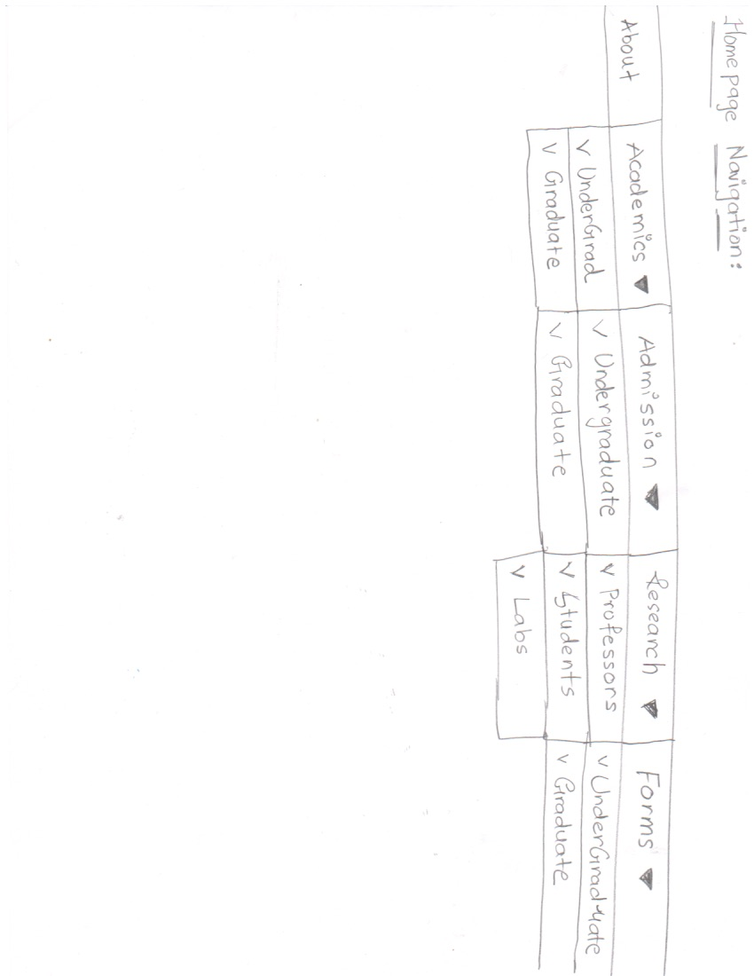
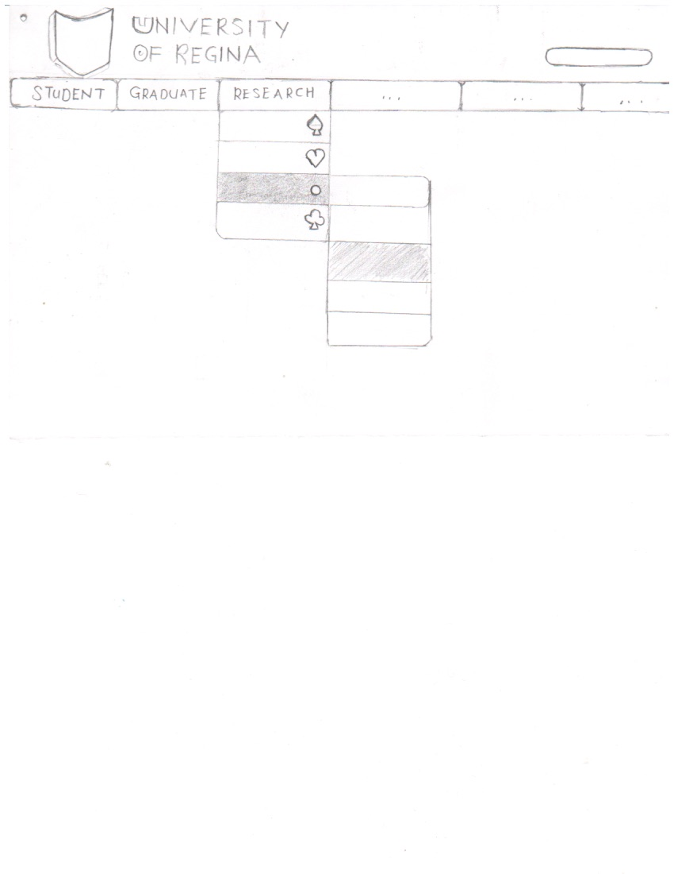

Slide 4
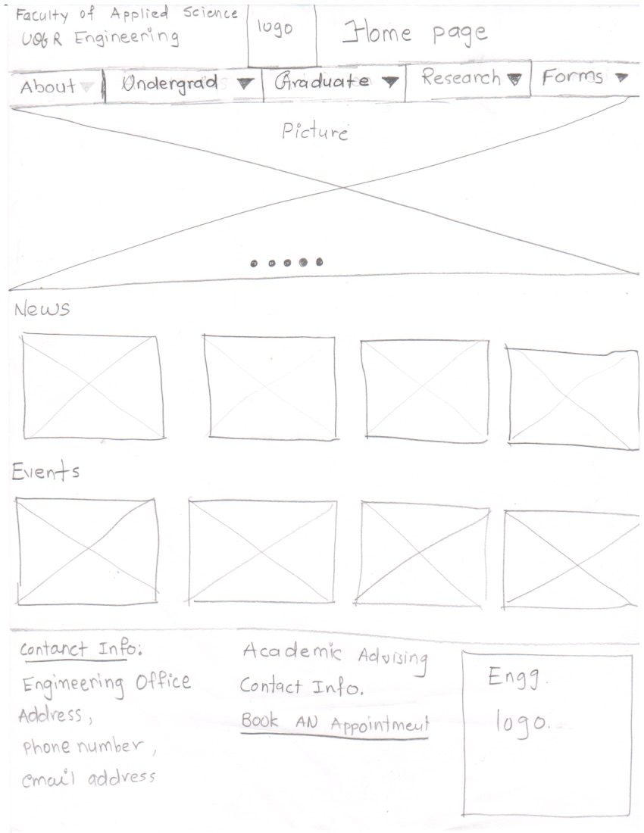

Slide 5
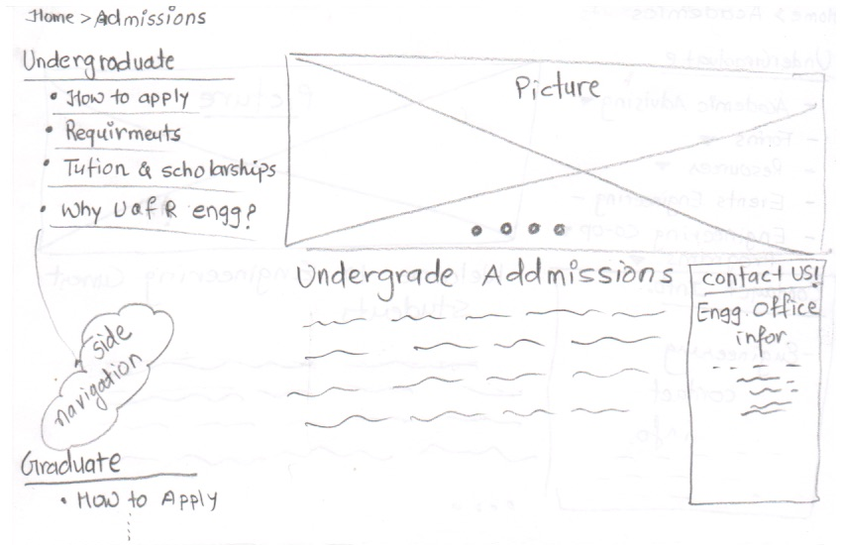
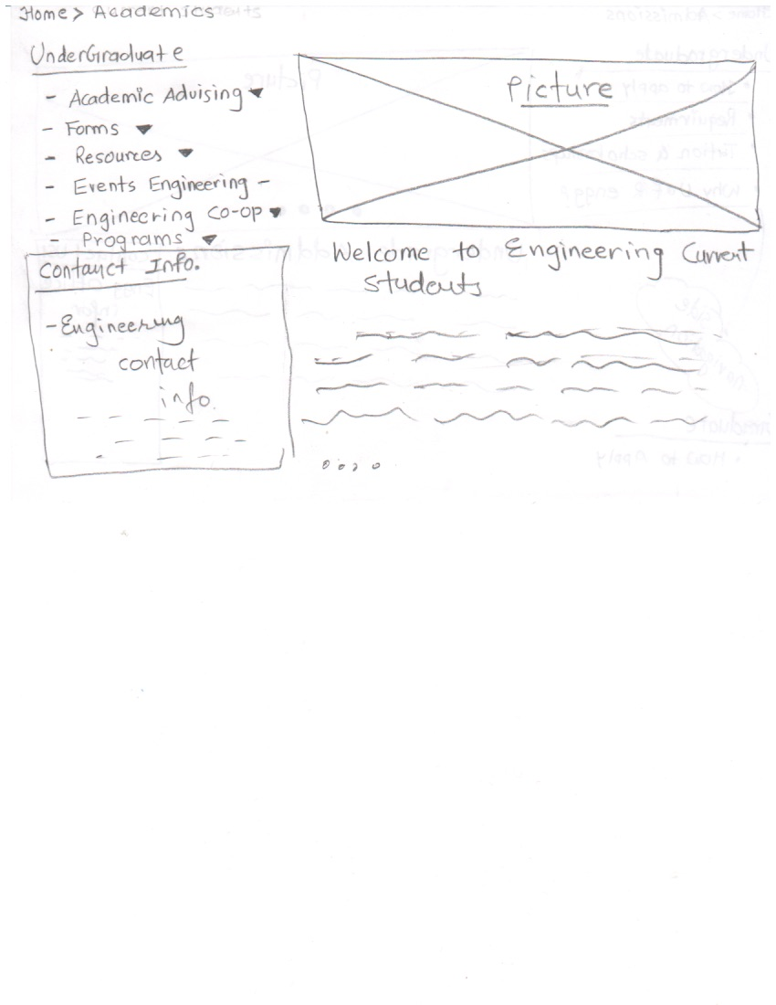
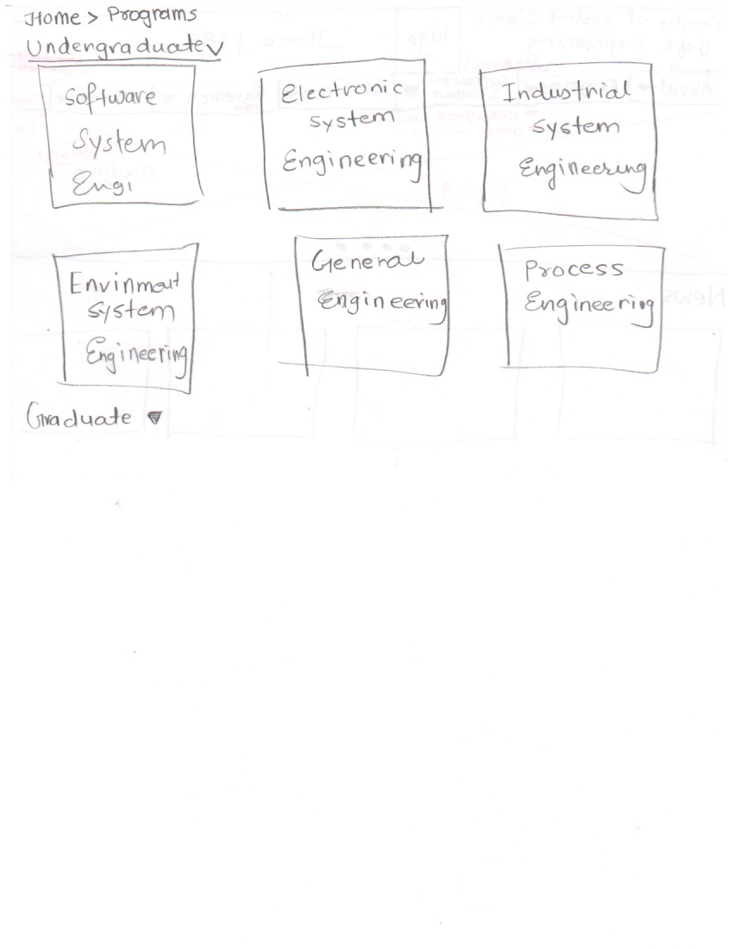
UNDERGRADUATE (Future and current students)
IDEATION #1

Slide 6
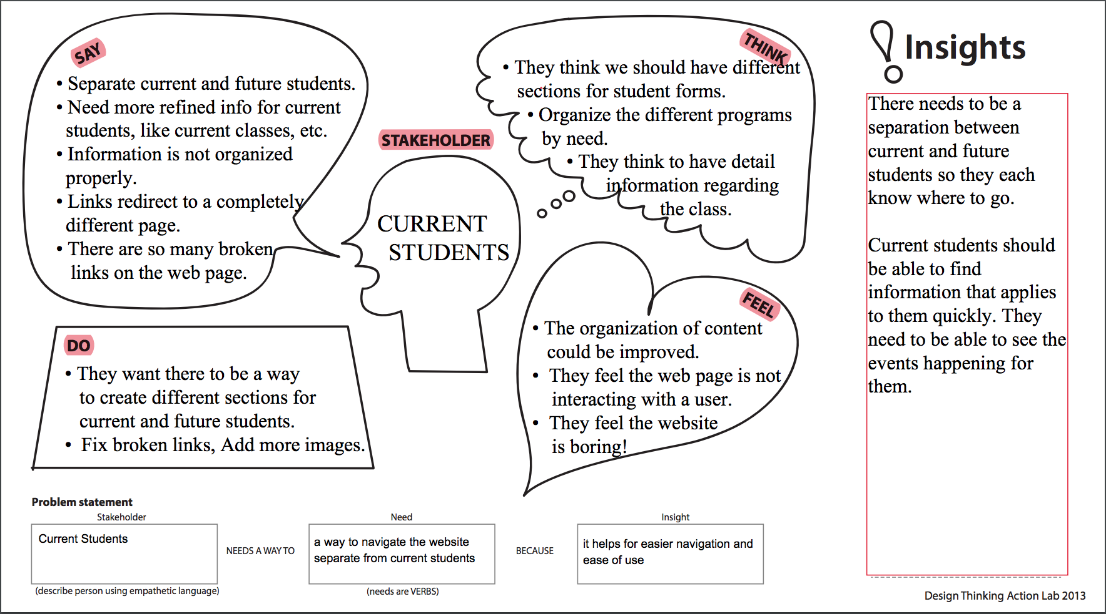

Slide 7
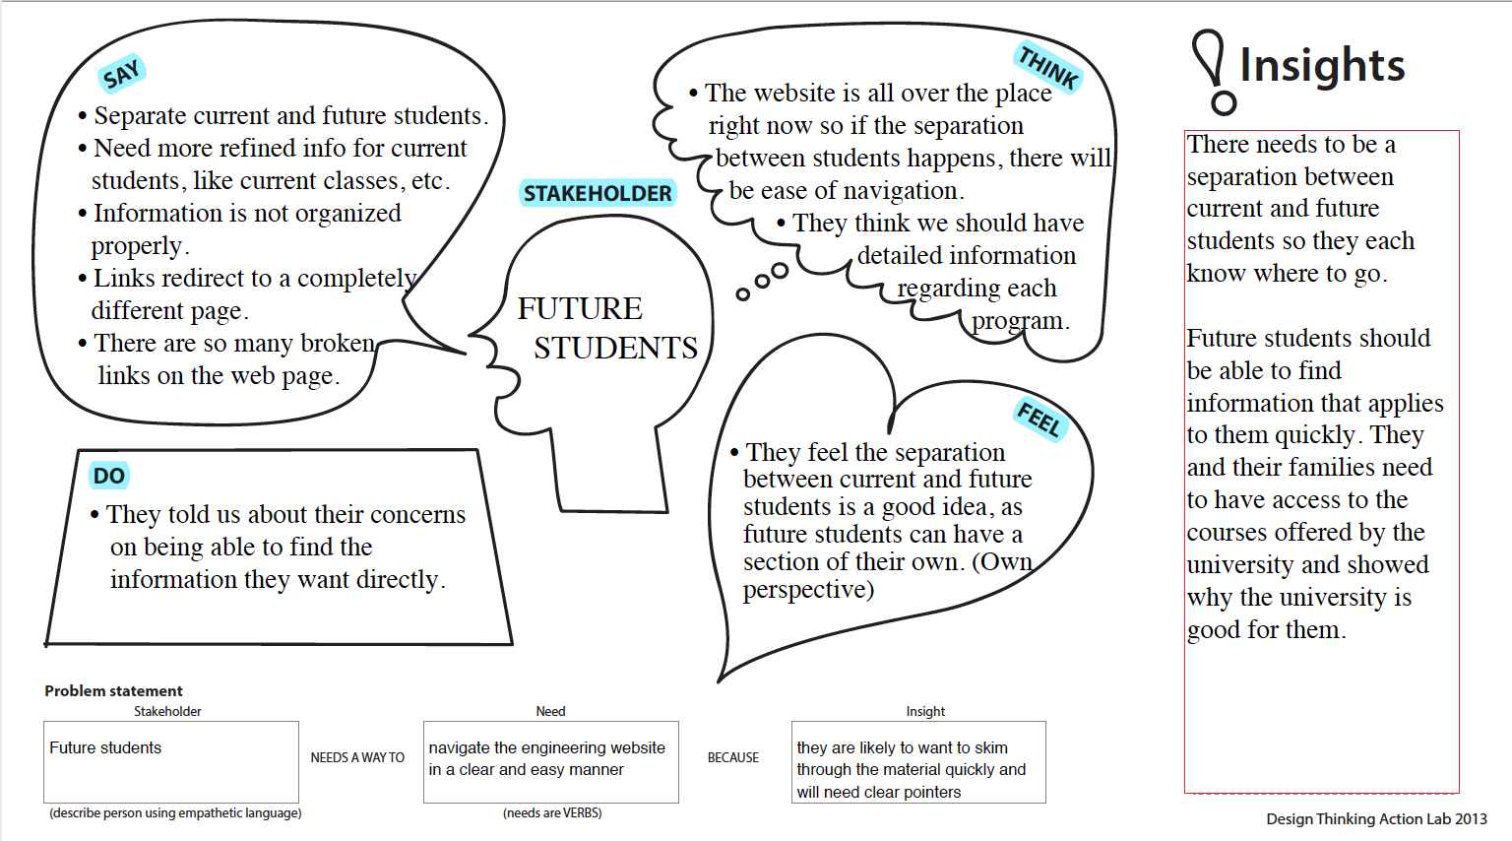

Slide 8
Feedback
Current Students and Future Students should be more clearly separated more than just having them both in the Undergrad section.
Include information on what courses that will be offered in the future.
Include possible jobs.

Slide 9
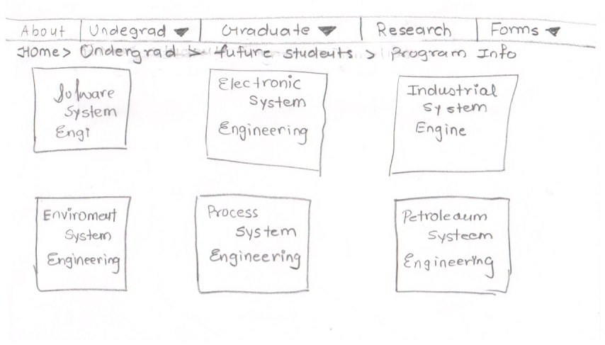
Future Students IDEATION #2
Each student can click on the program they want and get the information.
There will also be other related things under the future students menu.

Slide 10
Current Students IDEATION #2
Will have ways for a current student to get important information like academic advising, access events, and forms

Slide 11
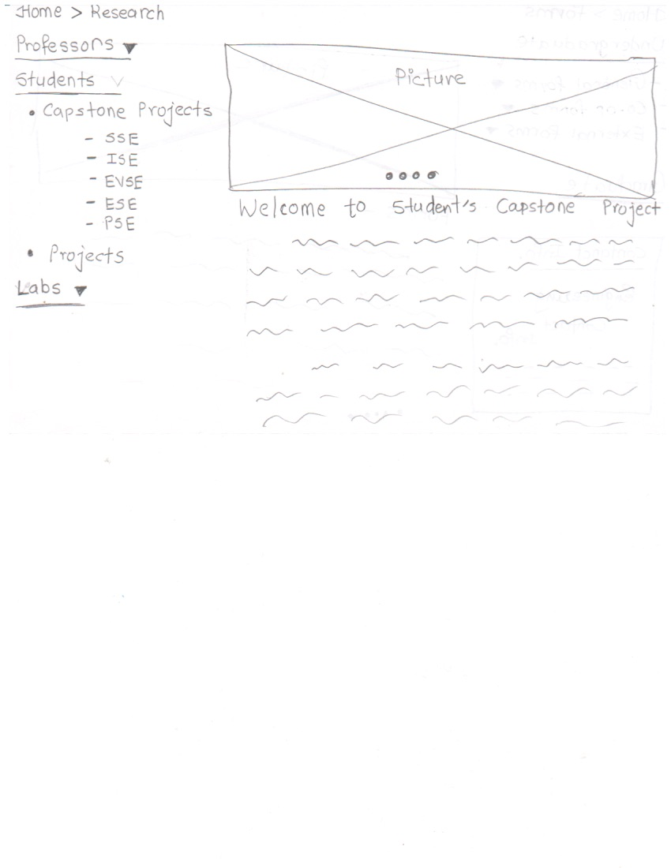
Research
IDEATION #1
Shows both students research and professors

Slide 12
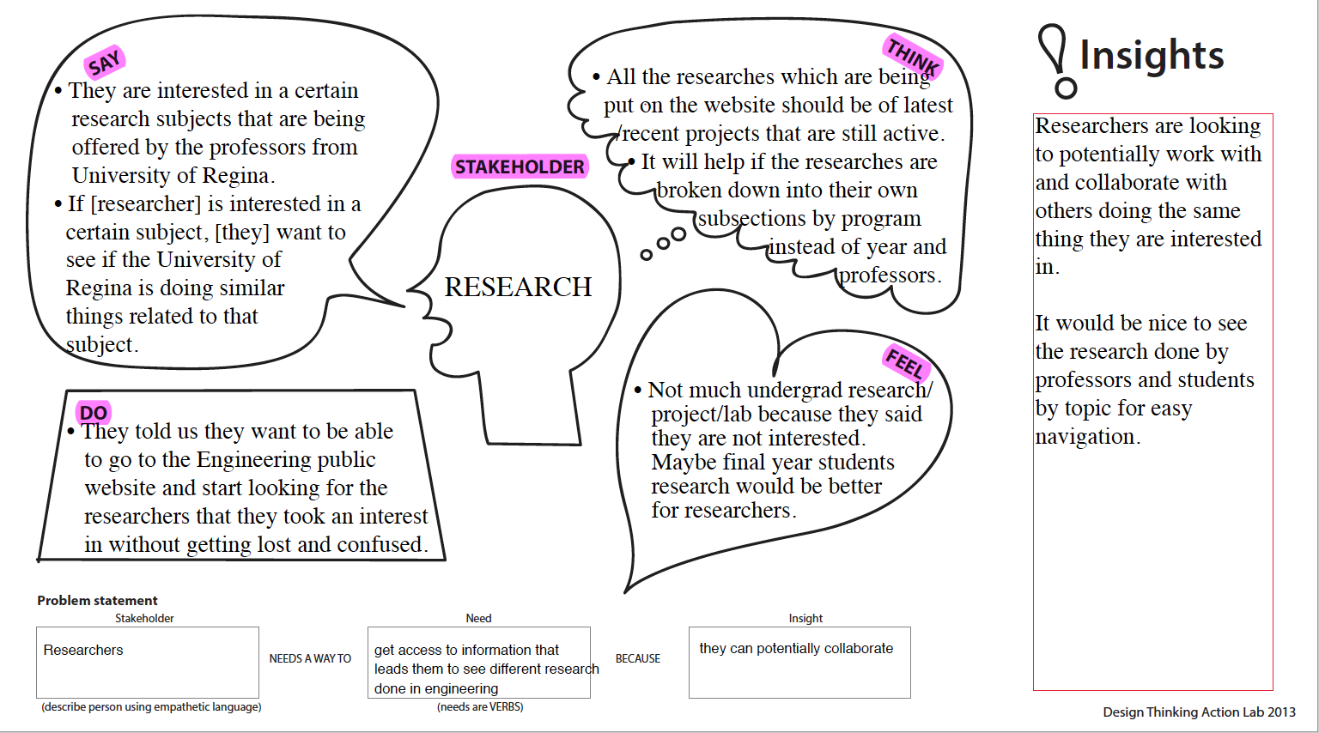

Slide 13
Feedback
They are interested in a certain research subject; they want to collaborate with people doing similar things related to that subject.
Information on the site should reflect that.

Slide 14
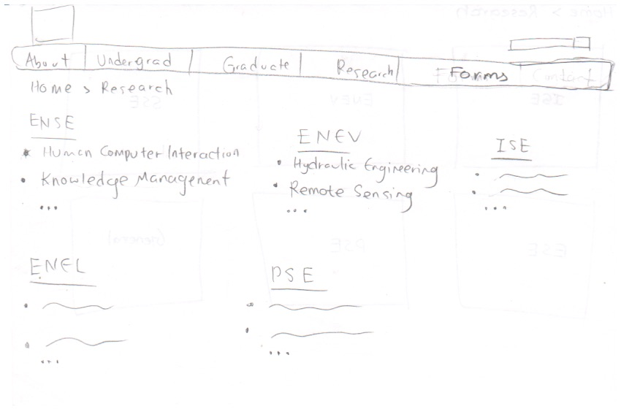
Research IDEATION #2
Now, we have the research separated by program and ordered alphabetically by topic

Slide 15
Graduate
IDEATION #1
Admissions has graduate and undergraduate
Graduate would have information on how to apply, courses and whatever else applies to the graduate student.

Slide 16
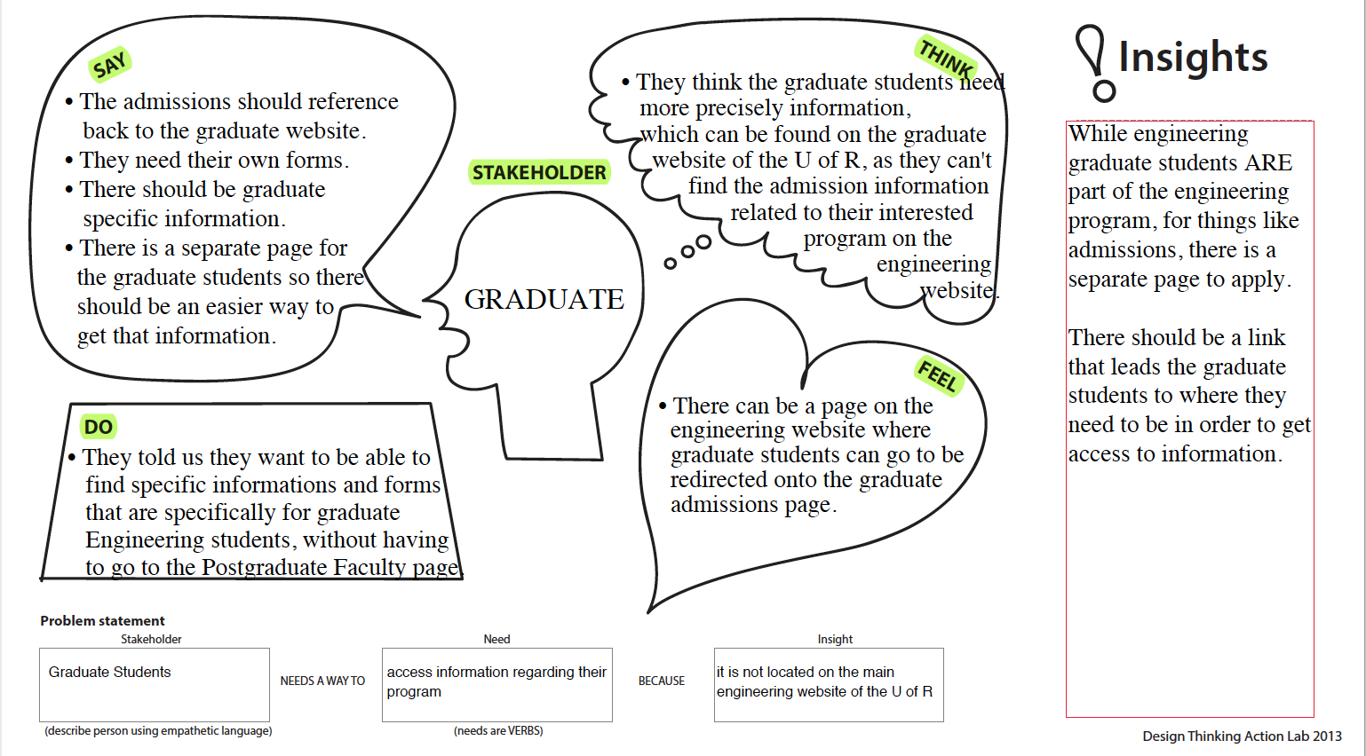

Slide 17
Feedback
The admissions should reference back to the graduate website
They need their own forms
There should be graduate specific information

Slide 18
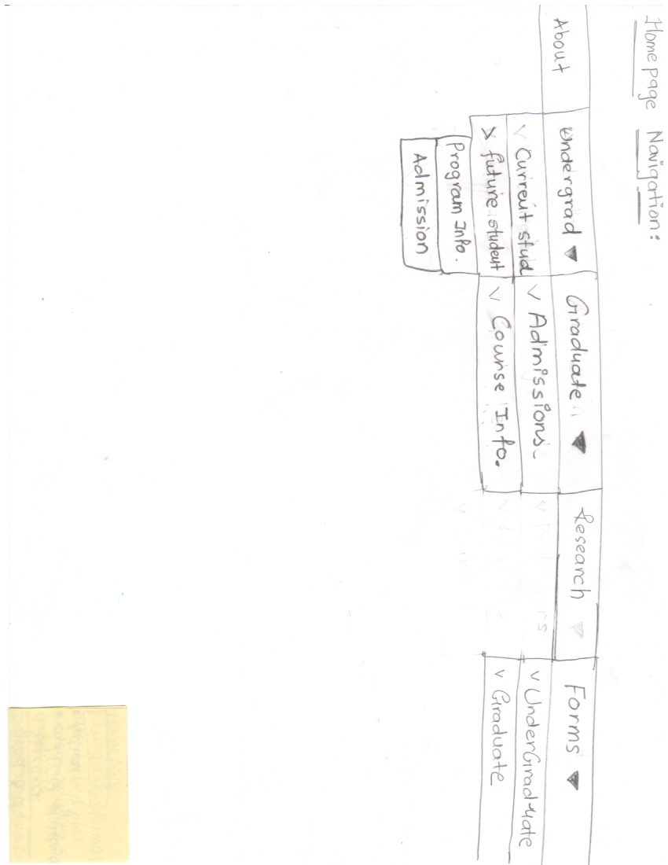
Graduate IDEATION #2
This will include the programs offered, as well as the course in them.
We will have a link that leads to the graduate studies website.

Slide 19
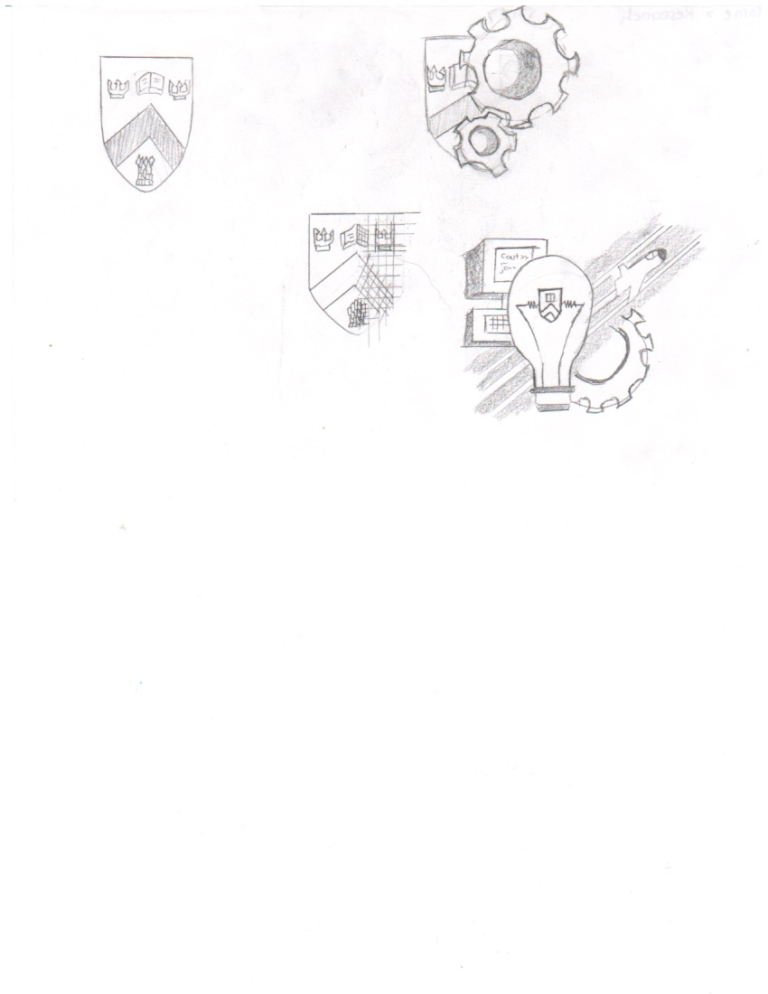
Logos
We wanted to have a recognizable logo for the engineering main page.

Slide 20
Experience with focus group
Pros
Making the unknown known
Learning from someone else’s perspective
Getting to know what the user wants
Cons
There’s never enough time to really pick their brains

Slide 21
Usability Questions
Future Students: “I want to be an industrial engineer. What courses would I need to focus on? And what do I need to know before coming in?”
Current Students: “I need to submit the “Letter of Permission” form. Where can I get this form and how do I submit it?
Graduate Students: “How should I do to contact with my professor on the website?”
Research: “I am looking for any interesting research that is available at the University of Regina, but I do not know which are still active and inactive.”

Slide 22
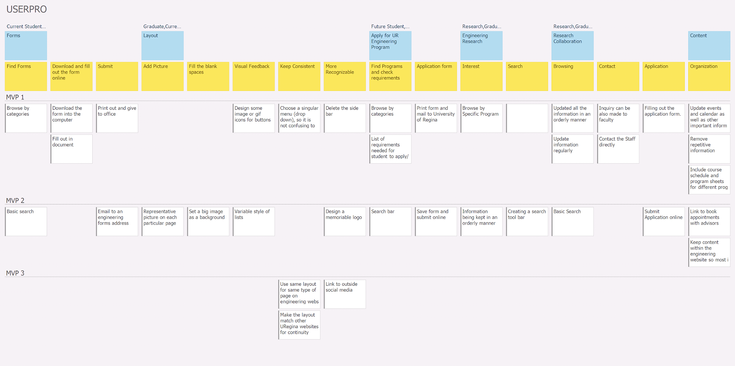

Slide 23
GitHub
https://github.com/zainshafiq/User-Interface-Programming-Human-Centered-Design-

Slide 24
Group Reflection
How we felt about this milestone?
We liked getting to talk to the focus group and getting a different perspective.
We liked this milestone as a whole, however, our other classes intruded on the amount of work we could get done.
What we learned about ourselves throughout this milestone?
Time management is important and we need to keep improving and as always, we are all respectful of everyone’s plans
We are all stressed :) and work makes us hungry
Notes:
Monday

Slide 25
Group Reflection
Going forward?
We will continue to be respectful towards each other as a group. This has been working great for our team
Get food first
Related things we want help with?
So far so good !
Opportunity to meet with focus group again. MayBe?

Slide 26
QUESTIONS?

